Slide 1

Understanding & Computing Riemann Sums
(in an iPhone app)
Andrew Owen - yumaikas94@gmail.com - www.junglecoder.com
Michael MacCallum - mickmaccallum@comcast.net

Slide 2
Overview
Riemann Sums
Programming
Regex

Slide 3
Motivations
Create an application that can…
    Check our homework
    Solve an interesting problem

Slide 4
Objectives
Intuitive usage (TI-83+ like syntax)
Freedom
    No Internet required
    No rate limiting
    Integrate on the go! (But not while driving)

Slide 5
What is a Riemann Sum?
Numerical method for approximating integrals
Calculated by summing the area of N rectangles or trapezoids below a function

Slide 6
Four Methods to Calculate Riemann Sums
Left
Right
Middle
Trapezoidal

Slide 7
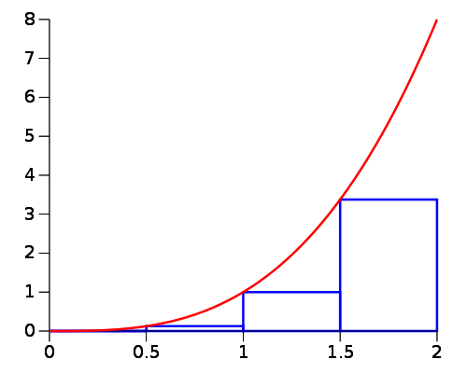
Left Sum

Slide 8
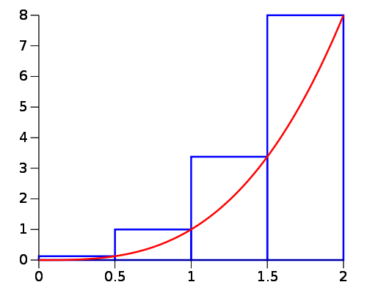
Right Sum

Slide 9
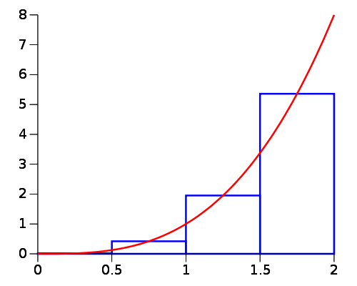
Middle Sum

Slide 10
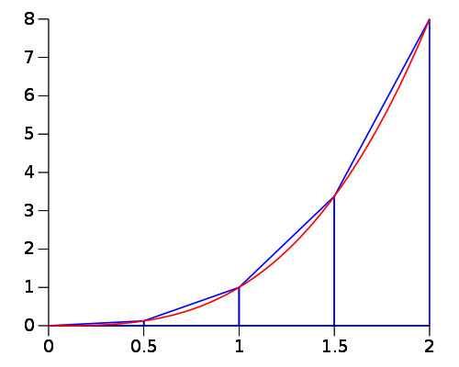
Trapezoid Method

Slide 11
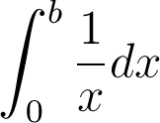
What isn’t a Riemann Sum?
Any function that isn’t integrable
Any definite integral with a vertical asymptote (ex: )
Areas larger than double max (around 1.797^308 for programs)

Slide 12
Implementation
Used 3rd party math parsers
Evaluate functions for every value of N * Delta X
Summed the results

Slide 13
Implementation
Math Parsers
  Objective-C - DDMathParser
      https://github.com/davedelong/DDMathParser/
  C# - YAMP
      https://github.com/FlorianRappl/YAMP

Slide 14
Implementation
double h = (b - a) / n;
for (unsigned int i = 0 ; i < n ; i ++) {
@autoreleasepool {
double x = a + i * h;
NSDictionary * const substitutions = @{var: @(x)};
NSNumber *eval = [expression evaluateWithSubstitutions:substitutions evaluator:nil error:&parseError];
double y = [eval doubleValue];
sum += y;
}
}
sum *= h;

Slide 15
Challenges
    Converting formulas for intuitive syntax
    Resolving performance issues
    Worked around floating point rounding errors

Slide 16
Converting formulas for Intuitive syntax
Aiming for TI-83-like syntax
“^” → “**” - DDMathParser (Objective-C)
“2x”→ “2*(x)” - YAMP (C#)
“2sinx”→ “2*sin(x)” - YAMP (C#)

Slide 17
Resolving Performance Issues
Comparing the programs
Objective-C was 100x slower than C#
Formula was being re-parsed for every value of x instead of being reused.
Fixing this lead to a 50x speed up

Slide 18
Worked Around Floating Point Rounding Errors
Computers don’t do fractions the way we do
0.1 + 0.1 ≈ 0.2

Slide 19
Conclusion
Definite integrals can be calculated on a mobile device, without the need to use the Internet or the Wolfram platform.

Slide 20
Open Source
This presentation - https://github.com/NSPostWhenIdle/RiemannSumsProject
Python Implementation - https://github.com/NSPostWhenIdle/PythonRiemannSums
C# Implementation - https://github.com/yumaikas/RiemannSums
Objective-C Implementation - https://github.com/NSPostWhenIdle/Riemann-Sums

